Slide 1
Instruction Types/Data Transfer and Manipulation
Computers provide an extensive set of instructions to give the user the flexibility to carry out various computational tasks.
The instruction set of different computers differ from each other mostly in the way the operands are determined from the address and mode fields.
Most computer instructions can be classified into three categories.
1. Data transfer instructions
2. Data manipulation instructions
3. Program control instructions
Data transfer instructions: Data transfer instructions move data from one place in the computer to another without changing the data content.
The most common transfers are between memory and processor registers, between processor registers and input or output, and between the processor registers themselves.
Table gives a list of eight data transfer instructions used in many computers with each instruction mnemonic symbol.

Slide 2
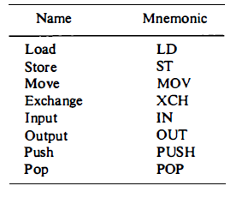
Typical Data Transfer Instructions
The load instruction has been used mostly to designate a transfer from memory to a processor register, usually an accumulator.
The store instruction designates a transfer from a processor register into memory.
The move instruction has been used in computers with multiple CPU registers to designate a transfer from one register to another. It has also been used for data transfers between CPU registers and memory or between two memory words.

Slide 3
The exchange instruction swaps information between two registers or a register and a memory word.
The input and output instructions transfer data among processor registers and input or output terminals.
The push and pop instructions transfer data between processor registers and a memory stack.
2. Data Manipulation Instructions: Data manipulation instructions perform operations on data and
provide the computational capabilities for the computer.
The data manipulation instructions in a typical computer are usually divided into three basic types:
1. Arithmetic instructions
2. Logical and bit manipulation instructions
3. Shift instructions

Slide 4
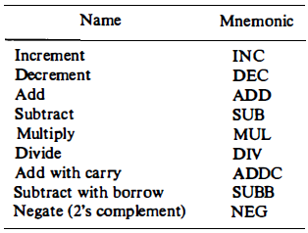
Arithmetic Instruction
The four basic arithmetic operations are addition, subtraction multiplication, and division.
Typical Arithmetic Instructions

Slide 5
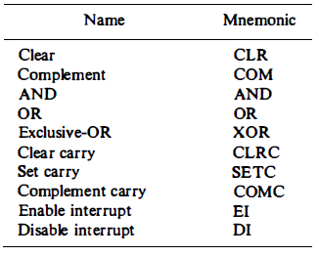
Logical and Bit Manipulation Instructions
Logical instructions perform binary operations on strings of bits stored in registers.
They are useful for manipulating individual bits or a group of bits that represent binary-coded information.
The logical instructions consider each bit of the operand separately and treat it as a Boolean variable.

Slide 6
Clear Selected Bits: There are three bit manipulation operations possible: a selected bit can be cleared to 0, or can be set to 1, or can be complemented.
The AND instruction is used to clear a bit or a selected group of bits of an operand.
For any Boolean variable x, the relationships xb0=0 and xb1=x dictate that a binary variable ANDed with a 0 produces a 0; but the variable does not change in value when ANDed with a 1.
Therefore, the AND instruction can be used to clear bits of an operand selectively by ANDing the operand with another operand that has 0' s in the bit positions that must be cleared.
Set Selected Bits: The OR instruction is used to set a bit or a selected group of bits of an operand. For any Boolean variable x, the relationships x + 1 = 1 and x + 0 = x dictate that a binary variable ORed with a 1 produces a 1; but the variable does not change when ORed with a 0.
Therefore, the OR instruction can be used to selectively set bits of an operand by ORing it with another operand with 1' s in the bit positions that must be set to 1.
Complement Selected Bits: Similarly, the XOR instruction is used to selectively complement bits of bits an operand.
This is because of the Boolean relationships x XOR 1 = x' and x XOR 0 = x. Thus a binary variable is complemented when XORed with a 1 but does not change in value when XORed with a 0.

Slide 7
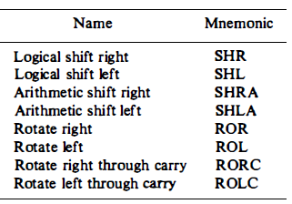
Shift Instructions
Shifts are operations in which the bits of a word are moved to the left or right. The bit shifted in at the end of the word determines the type of shift used.
Shift instructions may specify either logical shifts, arithmetic shifts, or rotate-type operations. Typical Shift Instructions are listed below
The logical shift inserts 0 to the end bit position. The end position is the leftmost bit for shift right and the rightmost bit position for the shift left.

Slide 8
Arithmetic shifts usually conform with the rules for signed-2' s complement numbers.
The arithmetic shift-right instruction must preserve the sign bit in the leftmost position. The sign bit is shifted to the right together with the rest of the number, but the sign bit itself remains unchanged. This is a shift-right operation with the end bit remaining the same.
The arithmetic shift-left instruction inserts 0 to the end position and is identical to the logical shift-left instruction. For this reason many computers do not provide a distinct arithmetic shift-left instruction when the logical shift-left instruction is already available.
The rotate instructions produce a circular shift. Bits shifted out at one end of the word are not lost as in a logical shift but are circulated back into the other end.
The rotate through carry instruction treats a carry bit as an extension of the register whose word is being rotated. Thus a rotate-left through carry instruction transfers the carry bit into the rightmost bit position of the register, transfers the leftmost bit position into the carry, and at the same time, shifts the entire register to the left.

